Slide 1

Forklift Manipulator – Final Presentation
Bård Løvik
Håvard Bakke
Mathias Matre
Thomas Nesse

Slide 2
Table of contents
Lattice planner
Controller
Robot arm
Robot Design

Slide 3
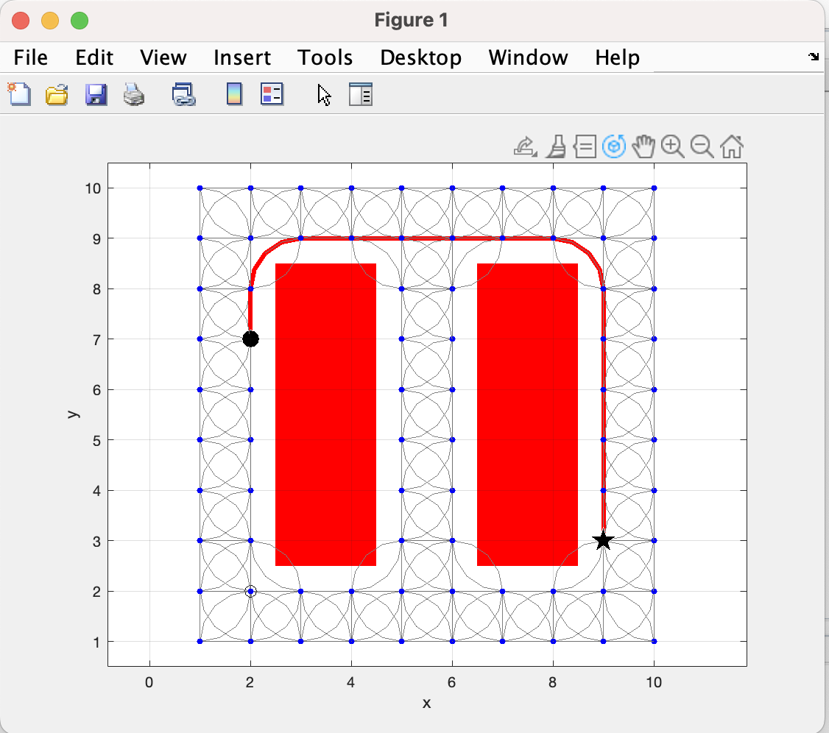
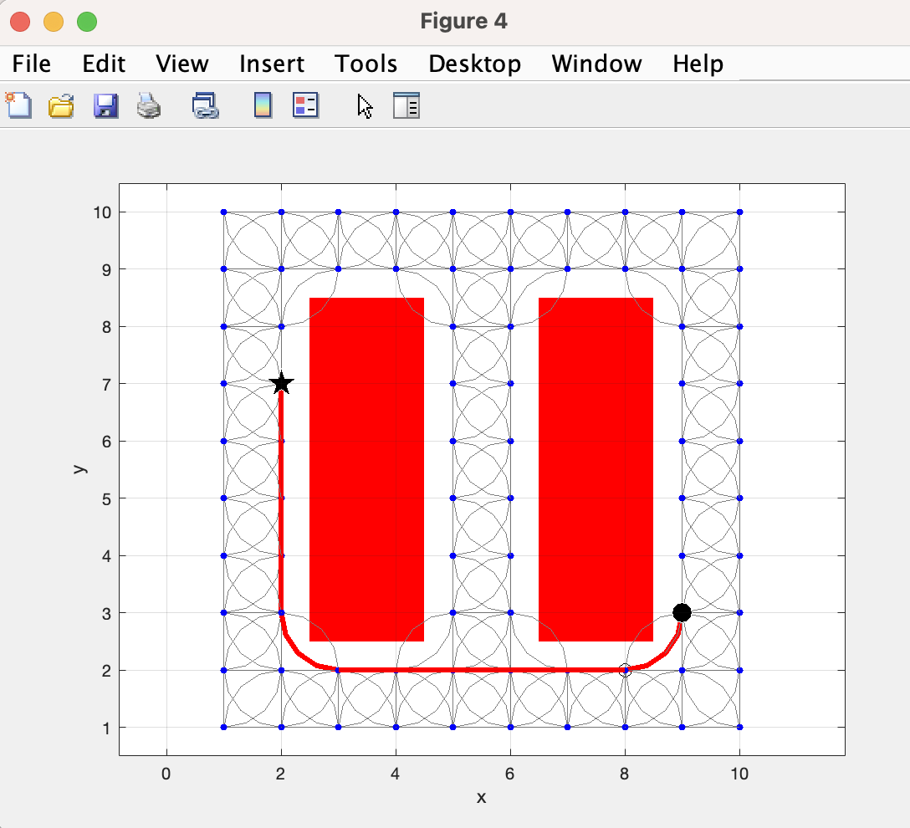
Lattice planner

Slide 4
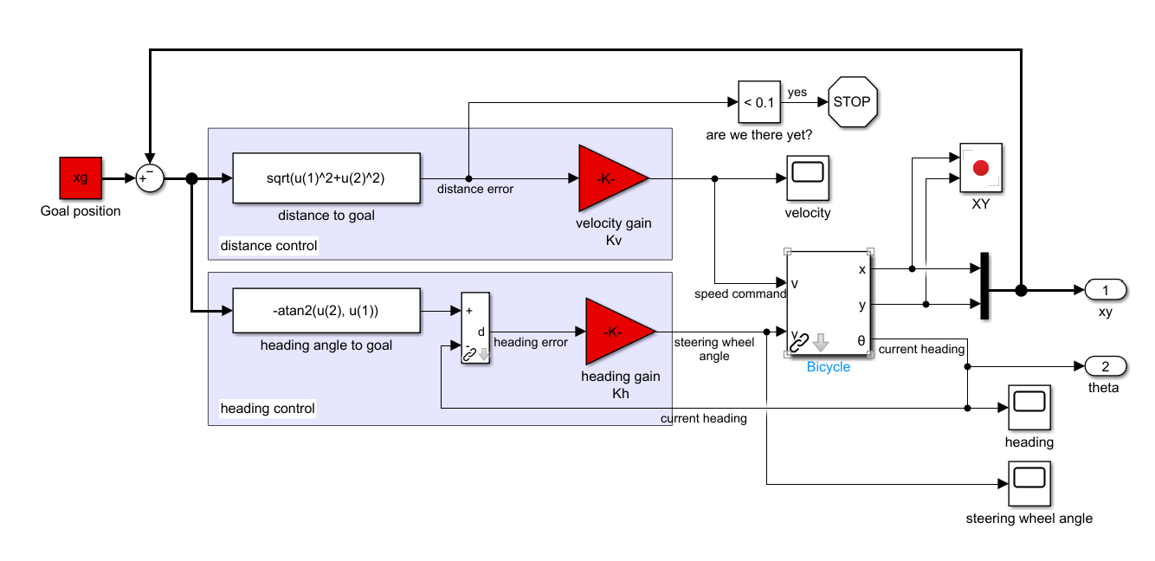
Controller
Implementering i Matlab
Sl_drivepoint
-k Heading Gain

Slide 5
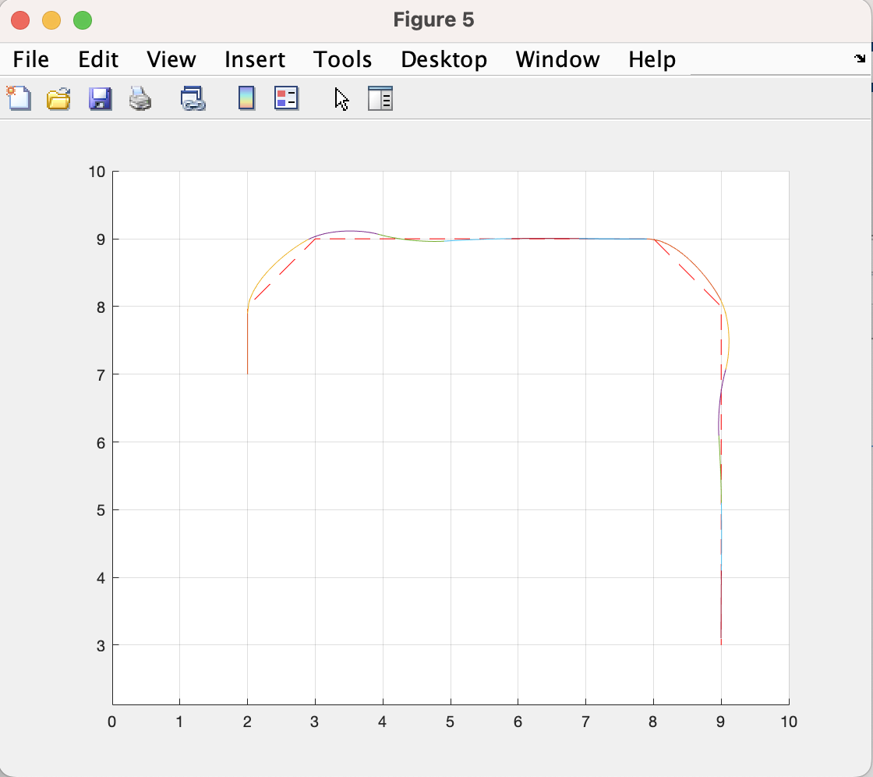
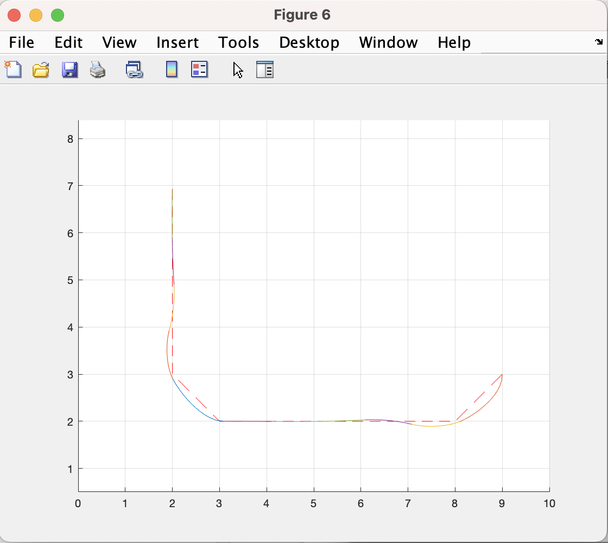
Controller

Slide 6
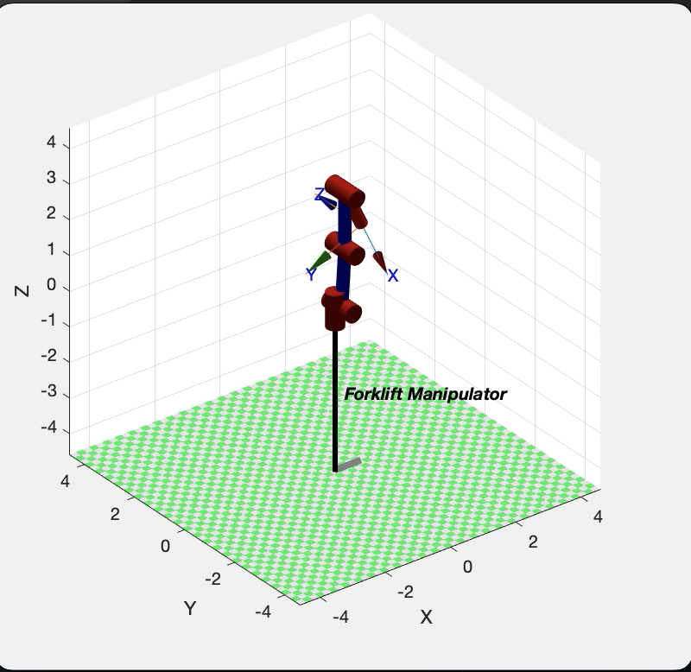
Robot arm
Picking up a pallet at location A, delivering to location B
Link to simulation
MATLAB to calculate force on each joint at maximum load (500kg)
Joint | 1 | 2 | 3 | 4
Force [kN] | 0 | 16.065 | 13.194 | 5.395

Slide 7
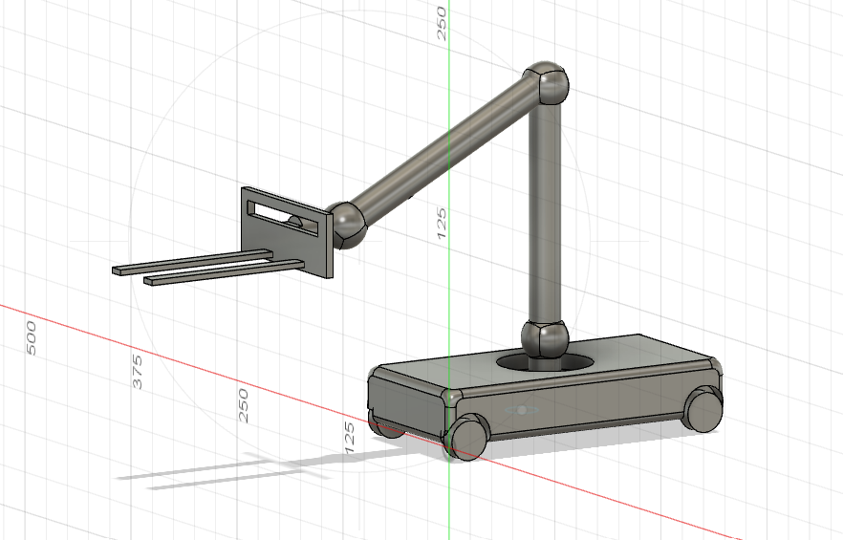
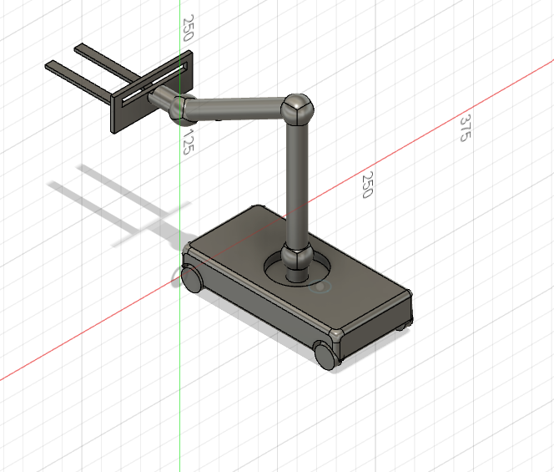
Robot design

